Slide 1
DEM by LiDAR Technology
By:
Ajay Kumar, OS,
National Geospatial Data Centre,
Survey of India, Dehradun.

Slide 2
Two main Deliverables of SOI under NHP
3-5m Accuracy DEM and Geodatabase of approx 8Lakh Sq Km area.
0.5m Accuracy DEM with Digital Ortho photos of River basins

Slide 3
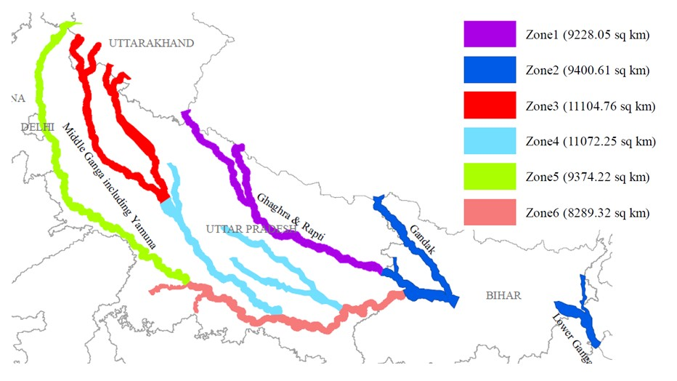
0.5m accuracy DEM area under NHP

Slide 4
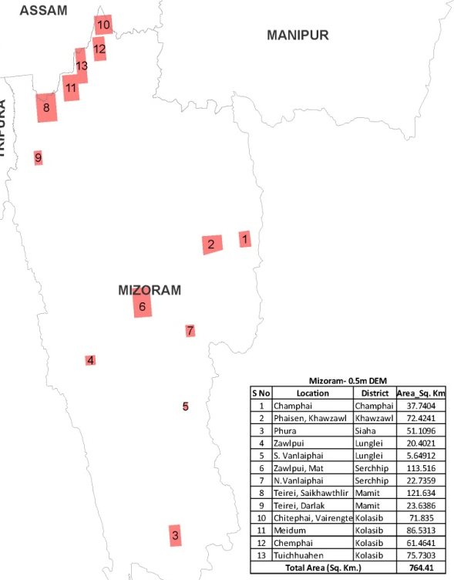
0.5m accuracy DEM area under NHP
0.5m DEM is being prepared using LiDAR Technology

Slide 5
DEM
DEM- Digital Elevation Model is the digital representation of the land surface elevation with respect to any reference datum.

Slide 6
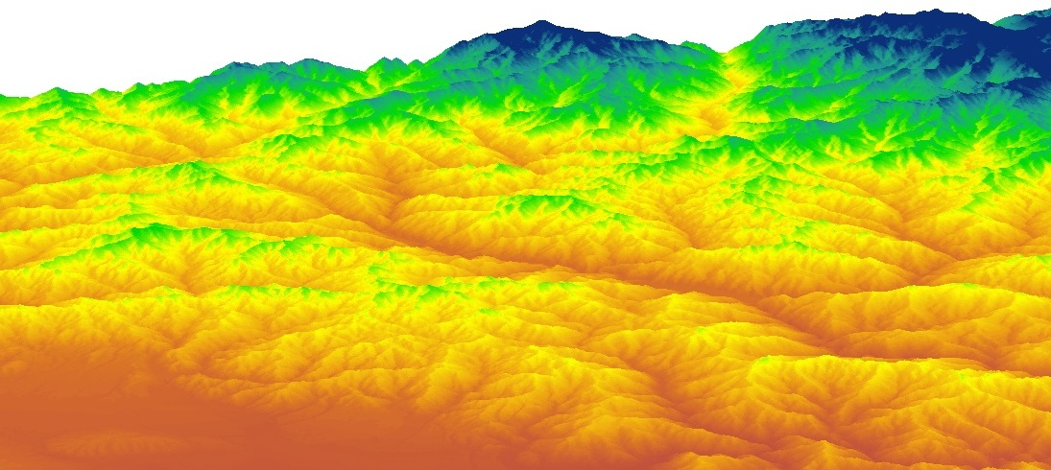
DEM
It can be described as simplest form of digital representation of topography.
used to determine terrain attributes such as elevation at any point, slope and aspect etc.

Slide 7
Methods for Creation of DEM
Common Methods for creating DEM are -
Land Surveying using Theodolite or Total station etc
Photogrammetry (by Airborne, Space borne or Drone mounted Camera)
Light Detection and Ranging (LiDAR)
Interferometric Synthetic Aperture Radar (IFSAR)

Slide 8
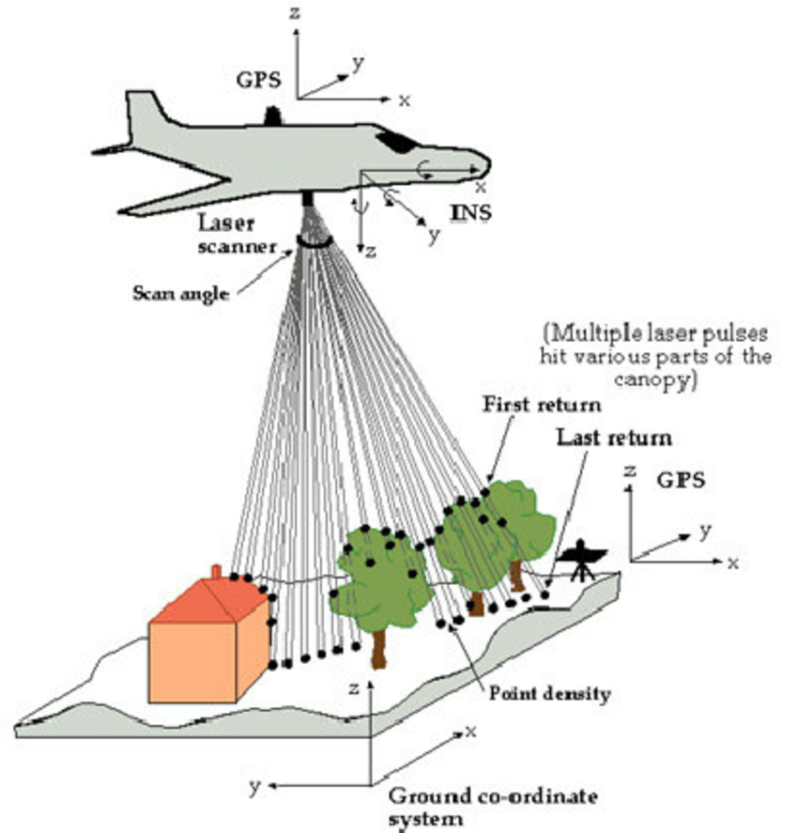
LiDAR
LiDAR(Light Detection And Ranging) is an optical remote sensing technology that can measure the distance to, or other properties of a target by illuminating the target with light , often using pulses from a LASER…, also known as Laser Altimetry.

Slide 9
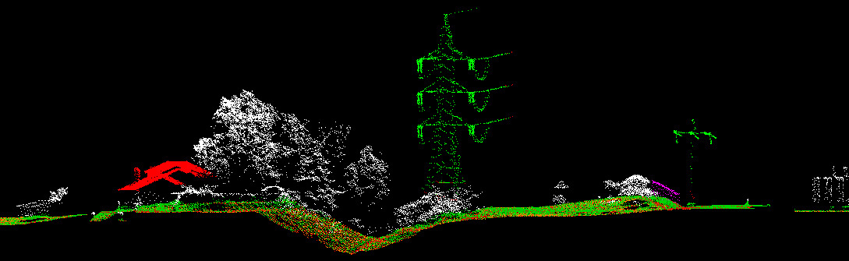
LiDAR
LiDAR capture and record geometry and textural information of visible surfaces of objects and sites and produce a quantitative 3D digital representation (point cloud, range map etc) of a surface in given field of view.

Slide 10
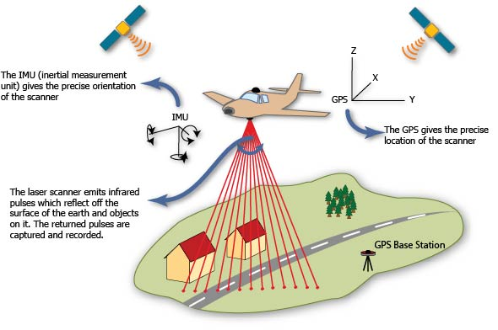
COMPONENTS of LiDAR SYSTEM
Global Navigation Satellite System (GNSS)
Inertial Navigation System (INS)
Laser Range Finder
Control and Data recording unit

Slide 11
COMPONENTS of LiDAR SYSTEM

Slide 12
1) GLOBAL NAVIGATION SATELLITE SYSTEM (GNSS)
Purpose: positioning of aircraft
Instrument: Receivers on top of aircraft and in terrain
Method: kinematic differential positioning

Slide 13
2) INERTIAL NAVIGATION SYSTEM (INS) or INERTIAL MEASUREMENT UNIT (IMU)
Purpose: attitude determination of aircraft
Instruments: gyroscopes and accelerometers’
Method: integration of accelerations

Slide 14
3) LASER RANGE FINDER (LASER SENSOR)
Purpose: distance measurement
Instrument: reflector less laser range finder
Method: time measurement laser pulse

Slide 15
4)CONTROL & DATA RECORDING UNIT
Control and Data recording unit
Time
Position
Orientation

Slide 16
LASER SENSOR
Reflector-less, but eye-safe
Scan angle: 20-40 degrees
Pulse frequencies: up to 500 kHz
Pulse length: 6-10 ns
Wave length: 0.9 -1.5 μm
Footprints: 20-100 cm depends upon flying Altitude
Range: 100 m -10 km
Standard camera mount

Slide 17
LASER SENSOR
Basic Measurement Principles
Light transit time estimation
For Long and mid range detection
Triangulation
For Short range detection

Slide 18
LIGHT TRANSIT TIME ESTIMATION
REFLECTION OF PULSES
reflection strength depends on terrain and wavelength reflection on terrain, buildings, trees, cars, etc multiple reflections of a single emitted pulse full waveforms.

Slide 19
LIGHT TRANSIT TIME ESTIMATION
DETECTION OF MULTIPLE ECHOES
Laser footprint “spot diameter” (For airborne systems20-100cm )
Can light more than one object within pulse diameter.
Discrete Pulse
Full wave form
Digitized wave form

Slide 20
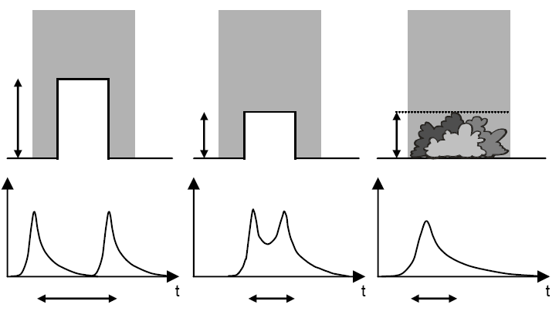
LIGHT TRANSIT TIME ESTIMATION
FULL WAVEFORM LASER SCANNERS
Signal analysis can be used to
Recognize multiple reflecting objects
Recognize surface roughness

Slide 21
SHORT RANGE DETECTION
By Light transit time estimation
Phase measurement techniques
By Triangulation techniques

Slide 22
SCANNING MECHANISM

Slide 23
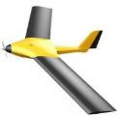
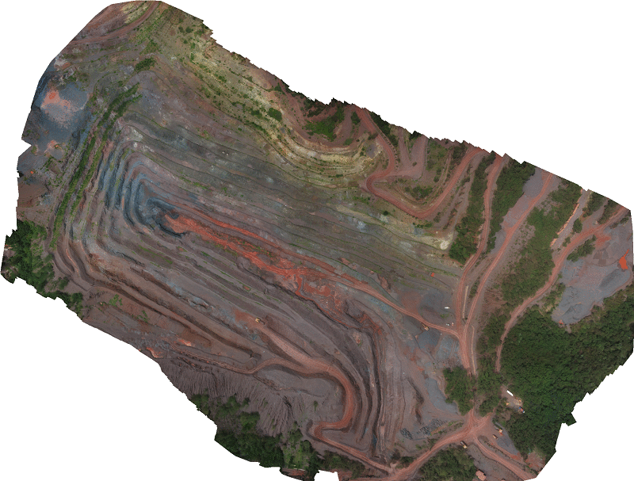
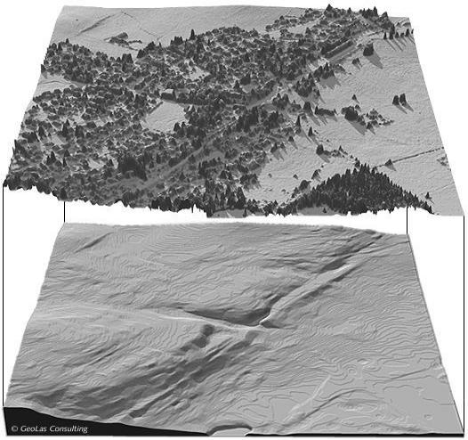
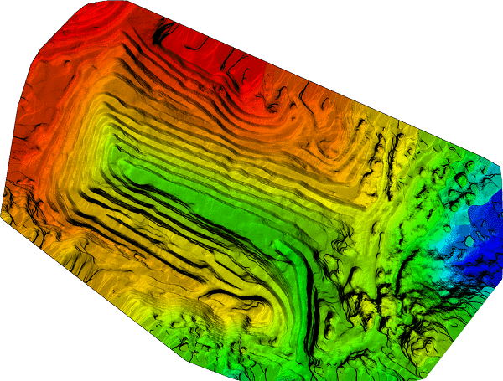
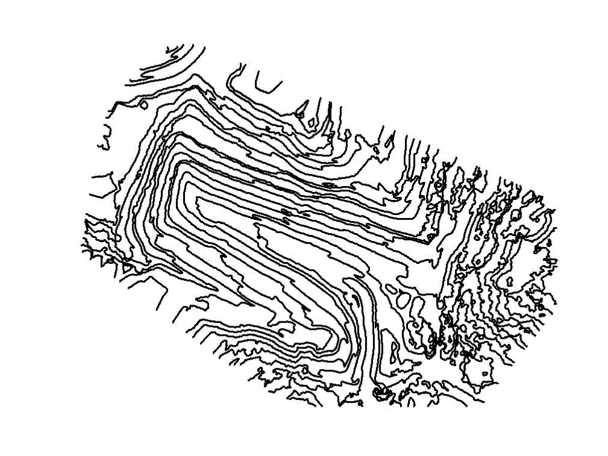
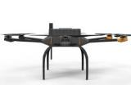
METHODOLOGY
PLAN
CAPTURE
PROCESS
ANALYSE
MAP/DEM

Slide 24
DATA PROCESSING

Slide 25
DATA PROCESSING
GPS Ground Station Data
Navigation Data (Onboard GPS and IMU data)
Ranging Data
Time tag
Amplitude (Discrete or Full wave form)
Scanner Parameter (Scan angle etc)
Echo counts
Other (e.g. Reflectance strength/ intensity data etc)

Slide 26
VISUALIZATION OF POINT CLOUD
To inspect completeness of Data recorded
To obtain first impression of data quality
Data completeness
Systematic height errors
Scanner artifacts
Systematic reflectance errors
Quality of filtering
Quality of extracted features

Slide 27
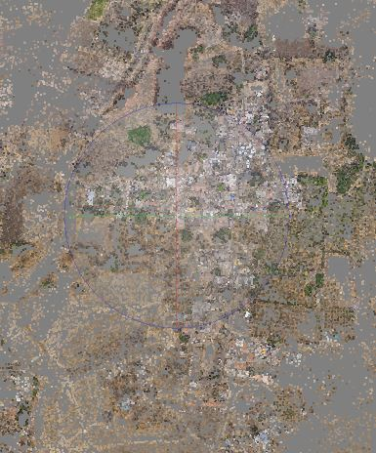
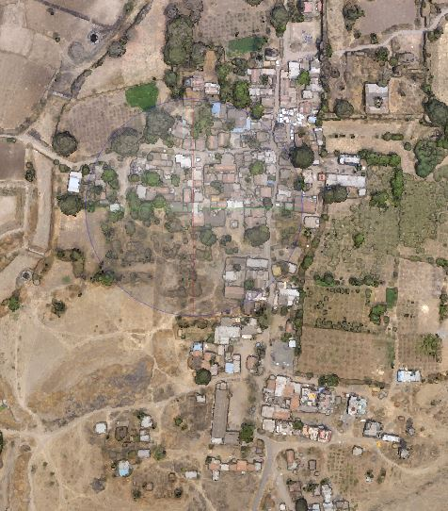
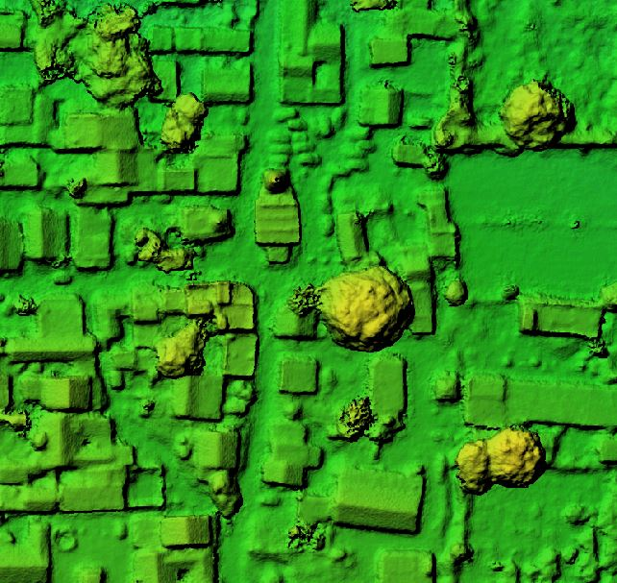
DATA PROCESSING
SPARSE POINT CLOUD (TIE POINTS)
DENSE POINT CLOUD
DIGITAL ELEVATION MODEL

Slide 28
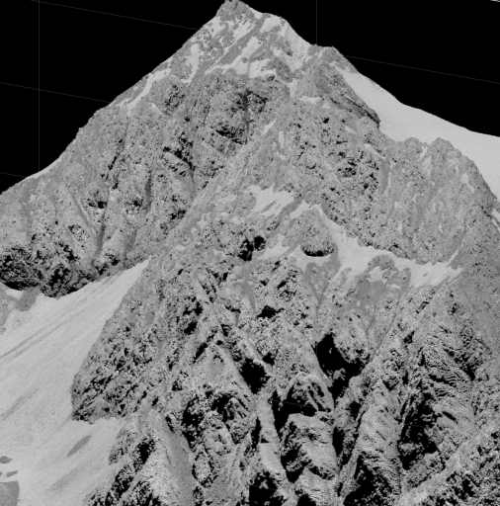
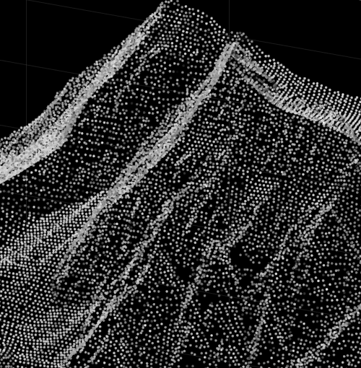
STRUCTURING OF POINT CLOUD
For extraction of information from point clouds
Extraction of smooth surfaces
Extraction of parameterized surfaces (planes, cylinders)
Connected components

Slide 29
STRUCTURING OF POINT CLOUD
Building Extraction by plane detection

Slide 30
FILTERING: EXTRACTION OF A DTM FROM A DSM

Slide 31
FILTERING: EXTRACTION OF A DTM FROM A DSM

Slide 32
ANALYSIS OF ACCURACY
Mapping accuracy determined by
Point spacing
Point distribution
Platform positioning noise
Systematic errors
Relative check by analyzing strip overlaps between parallel strips and cross strips
Checks against reference height data/maps

Slide 33
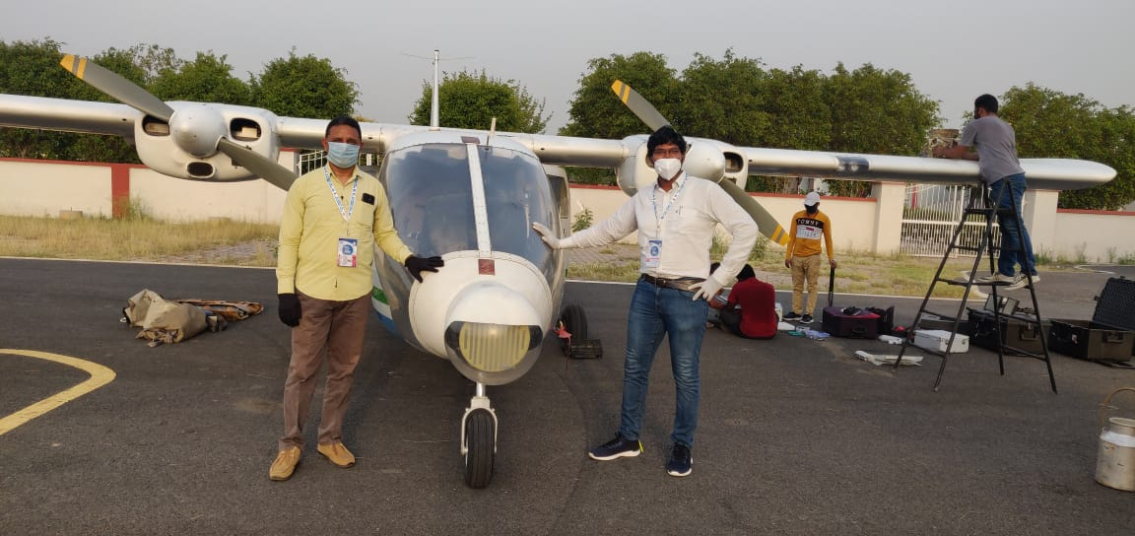
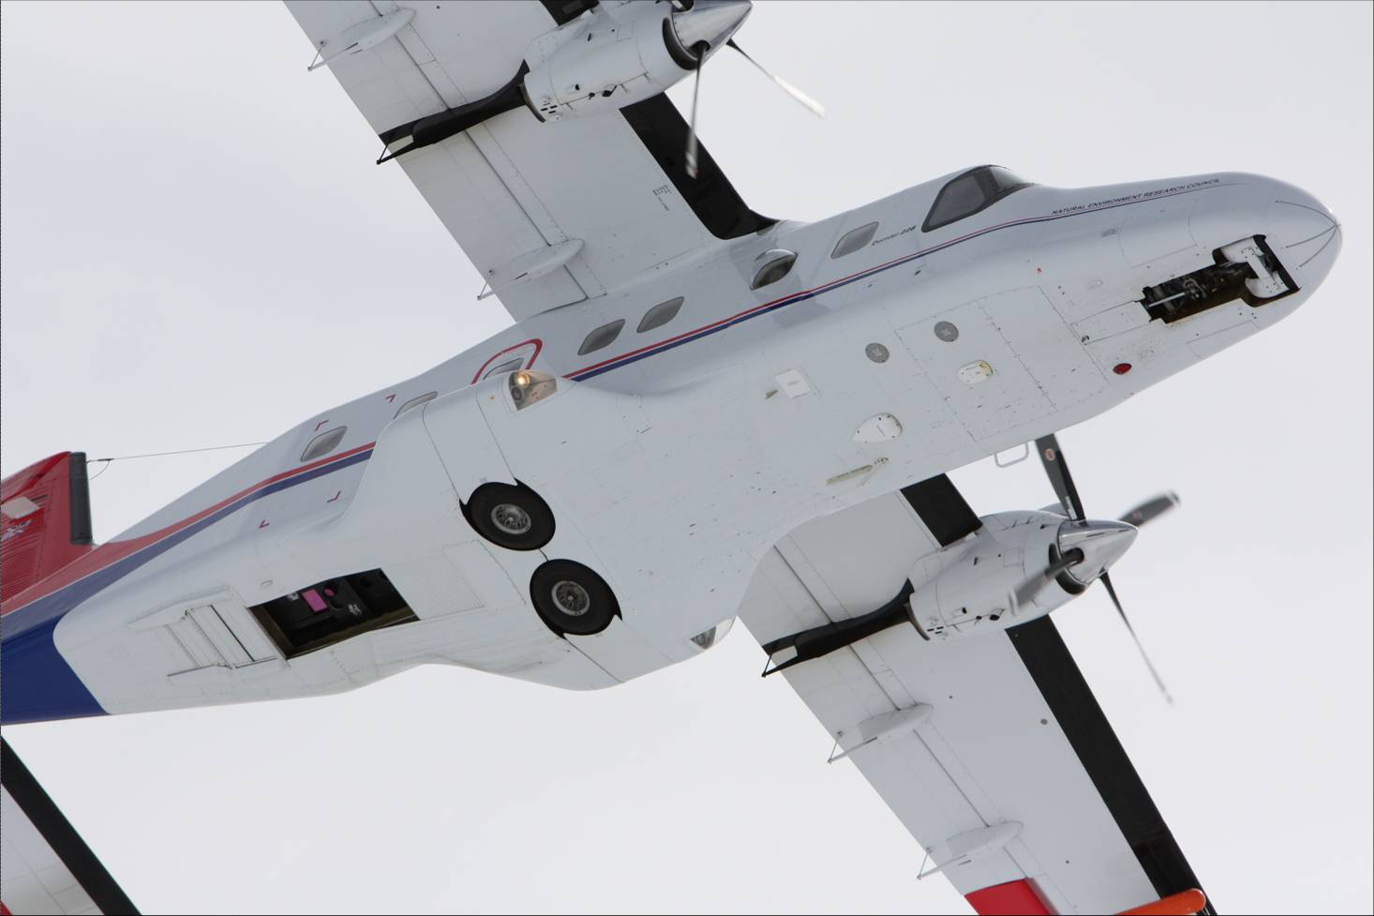
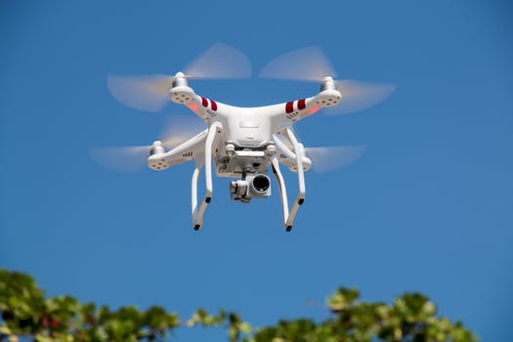
LIDAR Aircraft, UAV / Drone -

Slide 34
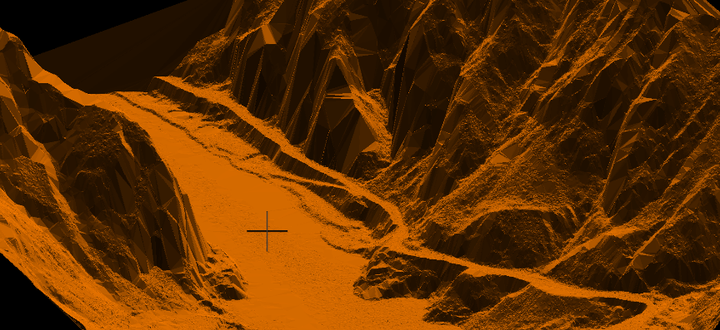
HIGH RESOLUTION POINT CLOUD OF DRONE BASED LIDAR

Slide 35
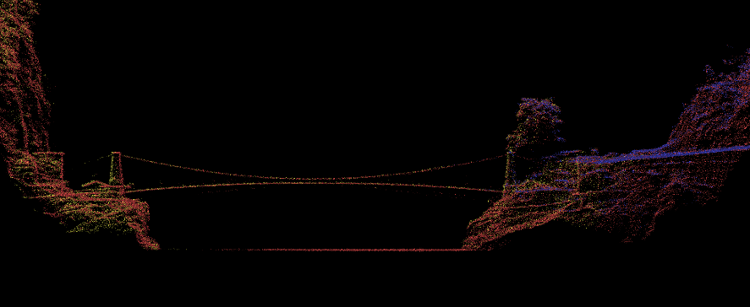
HIGH RESOLUTION POINT CLOUD OF DRONE BASED LIDAR

Slide 36
ADVANTAGES OF LIDAR TECHNOLOGY
Higher accuracy
Vertical accuracy 5-15 cm
Horizontal accuracy 30-50 cm
Fast acquisition and processing
Acquisition of 1000 km2 in 12 hours.
DEM generation of 1000 km2 in 24 hours.
Minimum human dependence
As most of the processes are automatic unlike photogrammetry, GPS or land surveying.
Weather/Light independence
Data collection independent of sun inclination and at night and slightly bad weather.
Canopy penetration
LiDAR pulses can reach beneath the canopy thus generating measurements of points there unlike photogrammetry.

Slide 37
ADVANTAGES OF LIDAR TECHNOLOGY
Higher data density
Up to 167,000 pulses per second. More than 24 points per m2 can be measured.
Multiple returns to collect data in 3D.
GCP independence
Only a few GCPs are needed to keep reference receiver for the purpose of DGPS. There is not need of GCPs otherwise.
This makes LiDAR ideal for mapping inaccessible and featureless areas.
Additional data
LiDAR also observes the amplitude of back scatter energy thus recording a reflectance value for each data point. This data, though poor spectrally, can be used for classification, as at the wavelength used some features may be discriminated accurately.
Cost
Is has been found by comparative studies that LiDAR data is cheaper in many applications. This is particularly considering the speed, accuracy and density of data.

Slide 38
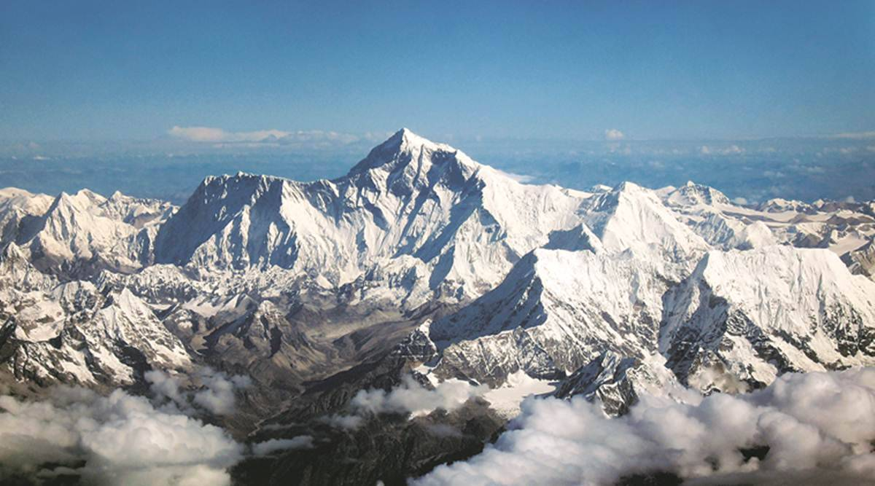
Thank you …

